Slide 1
CS M51A Discussion 2C Week #1
Hyunjin Kim

Slide 2
Announcement
TA: Hyunjin Kim (roykim0823@gmail.com)
Office Hour: Thursday 10am-12pm
Location: BH2432 (TA room)
Homework(6): 10%
Submit in the discussion
Check the old-numbered problems in the textbook (solutions on the CCLE site)
Quizzes(4): 20%
Taken in the discussion
Questions
Post your question on discussion forum in CCLE

Slide 3
In Discussion, WE DO
Homework Review
Problem Solving
Logisim Design
Q & A
Quizes

Slide 4
For Better Discussion, You DO
Feedback
Any comments are welcome.
The material that you are confused about
Specify a slide number, a exercise number, etc.

Slide 5
Outline
Number conversion
binary, Octal, Hexadecimal, or Decimal
fixed or mixed-radix
Boolean Algebra (Appendix A)
Function Specification
Logisim Demo

Slide 6

Integer Domain Conversion
Decimal | Binary
0 | 0000
1 | 0001
2 | 0010
3 | 0011
4 | 0100
5 | 0101
6 | 0110
7 | 0111
8 | 1000
9 | 1001
10 | 1010
11 | 1011
12 | 1100
13 | 1101
14 | 1110
15 | 1111
Decimal: 10^{i}
Binary: 2^{i}
Example
37
511
(10111101)₂
(1234)₈
(EC76)₁₆ ->(?)₈

Slide 7
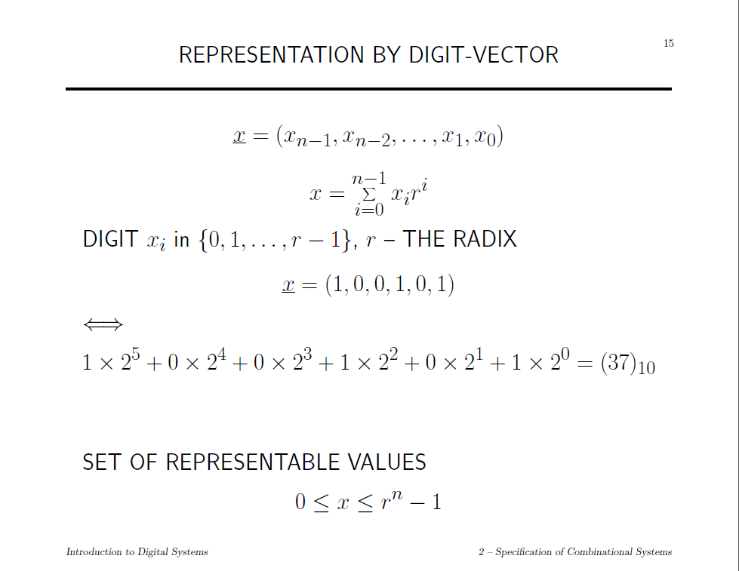

Slide 8
Mixed-Radix
X=(x, y, z) is a 3-digit weighted mixed-radix number system: x is a radix-16, y is a radix-3, and z is a radix-12
Convert X=(6, 1, 11) to a decimal number
The largest number of X in decimal?
LargetstX = r_{n-1} x r_{n-2} x … x r₀ -1 = 16 x 3 x 12 - 1 = 576 – 1 = 575

Slide 9
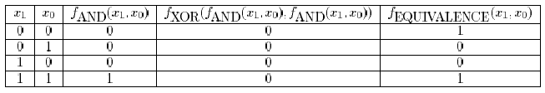
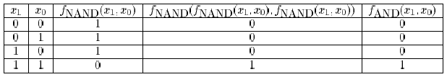
EX 2.15
Prove or Disprove the following:
f_{XOR}(f_{AND}(x₁, x₀), f_{AND}(x₁, x₀))=f_{EQUIVALENCE}(x₁, x₀)
f_{NAND}(f_{NAND}(x₁, x₀), f_{NAND}(x₁, x₀))= f_{AND}(x₁, x₀)

Slide 10
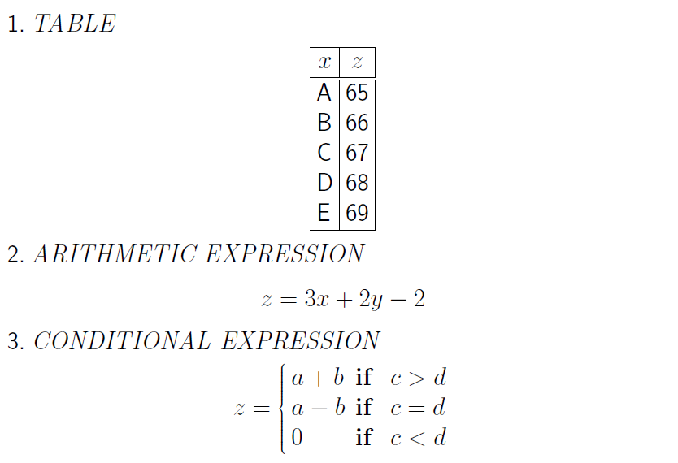
Function Expression

Slide 11
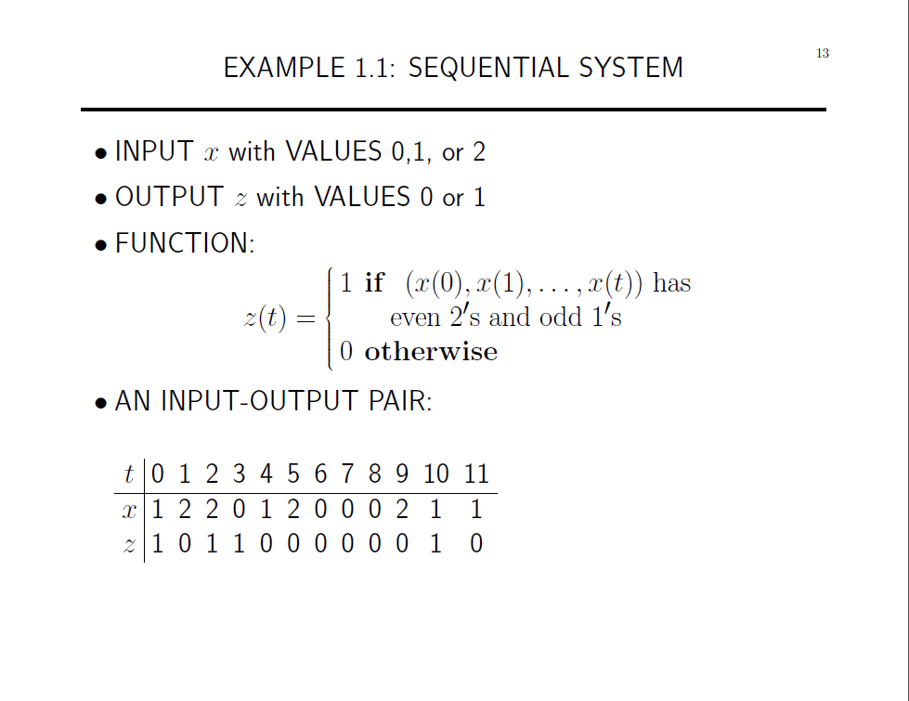

Slide 12
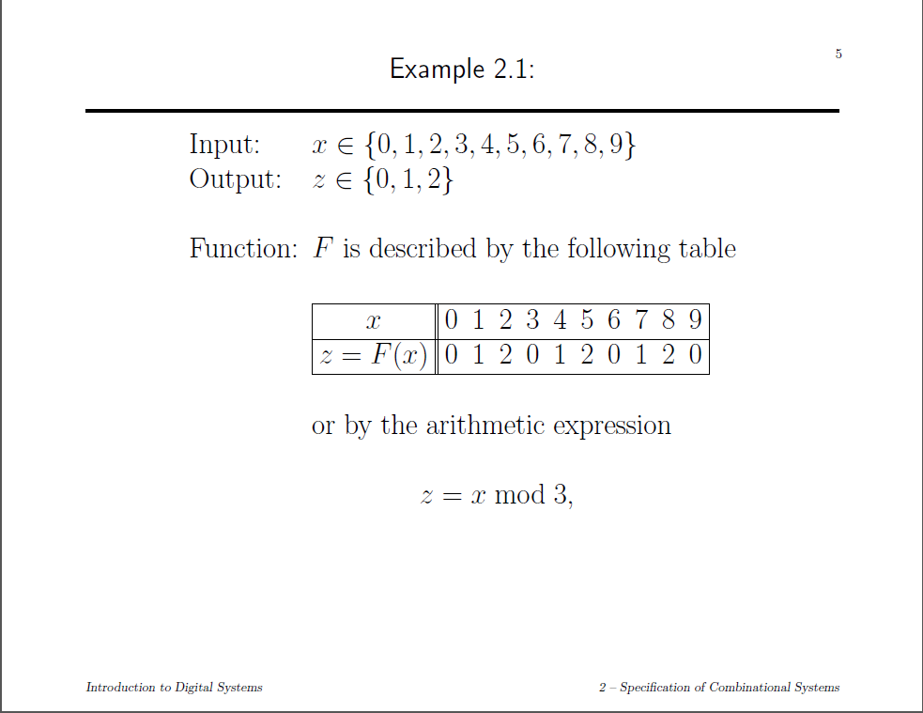

Slide 13
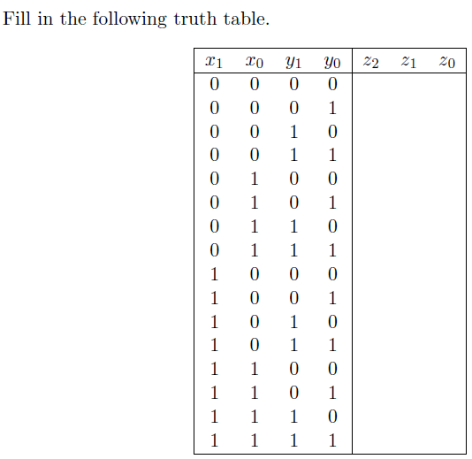
0 0 0
0 0 1
0 1 0
0 1 1
0 0 1
0 1 0
0 1 1
1 0 0
1 0 0
1 0 1
1 1 0
1 1 1
- - -
- - -
- - -
- - -

Slide 14
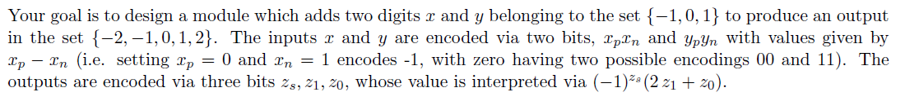
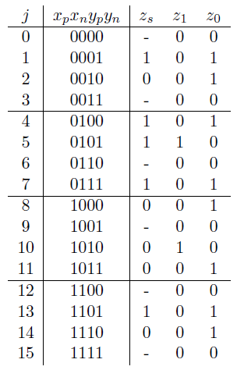

Slide 15
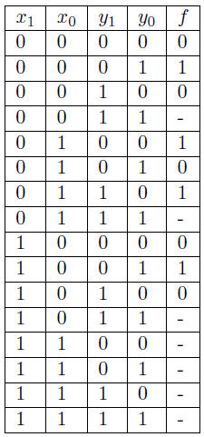

f(x, y) is a function which accepts inputs x, y ∈ {0, 1, 2}. We use the binary code to encode x and y. The following is the tabular form of the function f.
Describe the function f(x, y).
f(x, y) = (x+y) mod 2
-> The parity of x + y

